Slide 1
AMERICAN FOOTBALL
NFL DREAM TEAM

Slide 2
OUR
TEAM
Kenny Ross
Stephanie Rathod
Geoff Wilson
Henry Nguyen

Slide 3
ABOUT THE PROJECT
Construct a model for predicting the ultimate fantasy football team. Leveraging techniques acquired, we will utilize fantasy football statistics from 2019 to 2023 to forecast the optimal team composition for 2024.

Slide 4
FANTASY FOOTBALL EXPLAINED
05
GAME DAY
Basics
Players and Positions
Scoring System
Other rules and settings
HOME
12:34
VISITOR
20
15
DOWN
TO GO
BALL ON
QTR
01
00
21
04

Slide 5
ETL PROCESS
Located dataset with necessary information
Extracted CSV files for years 2019 -2023
Joined CSV files for dataframe
Cleaned data and dropped missing values
Formatted data frame in a manner suitable for machine learning
Loaded data into model to train and make predictions (went from 84% to 90% accuracy)

Slide 6
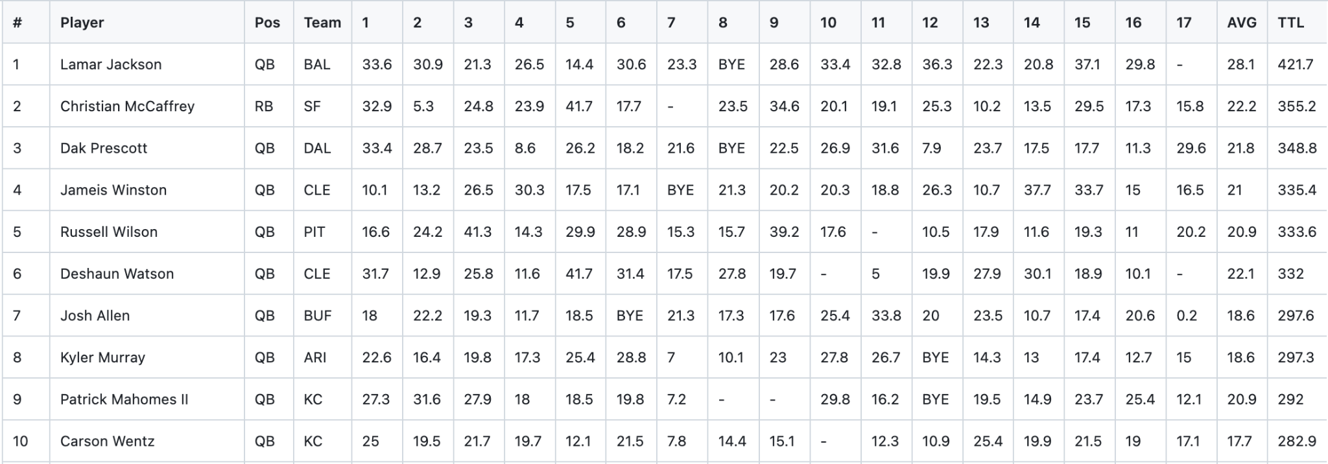
PLAYER STATS 2019

Slide 7
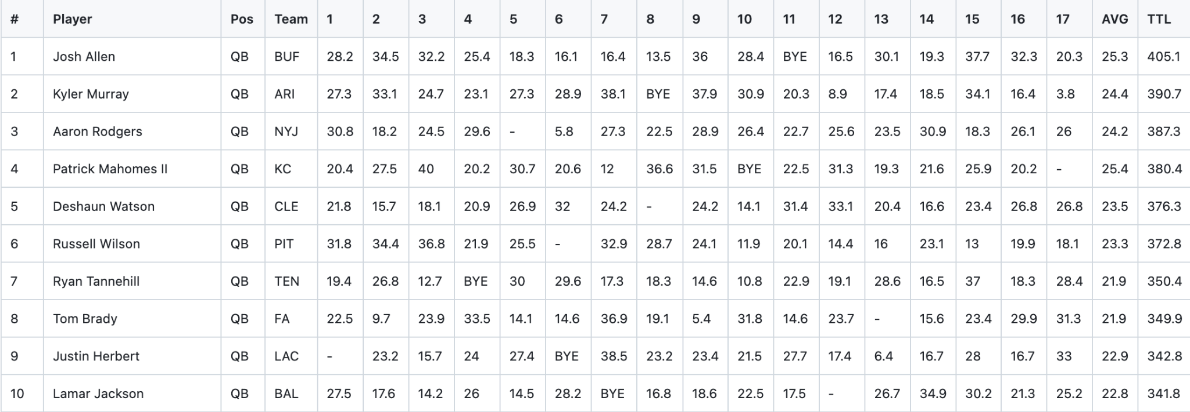
PLAYER STATS 2020

Slide 8
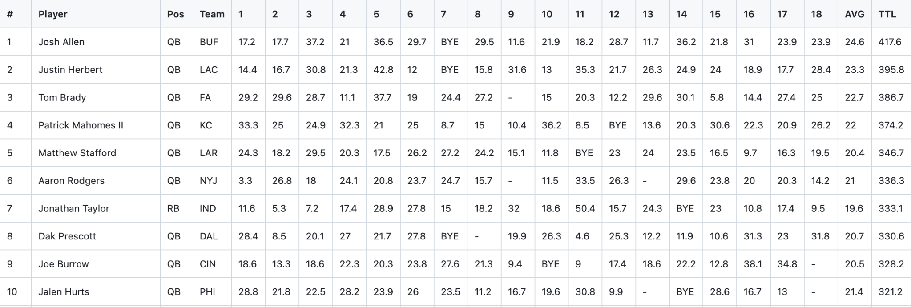
PLAYER STATS 2021

Slide 9
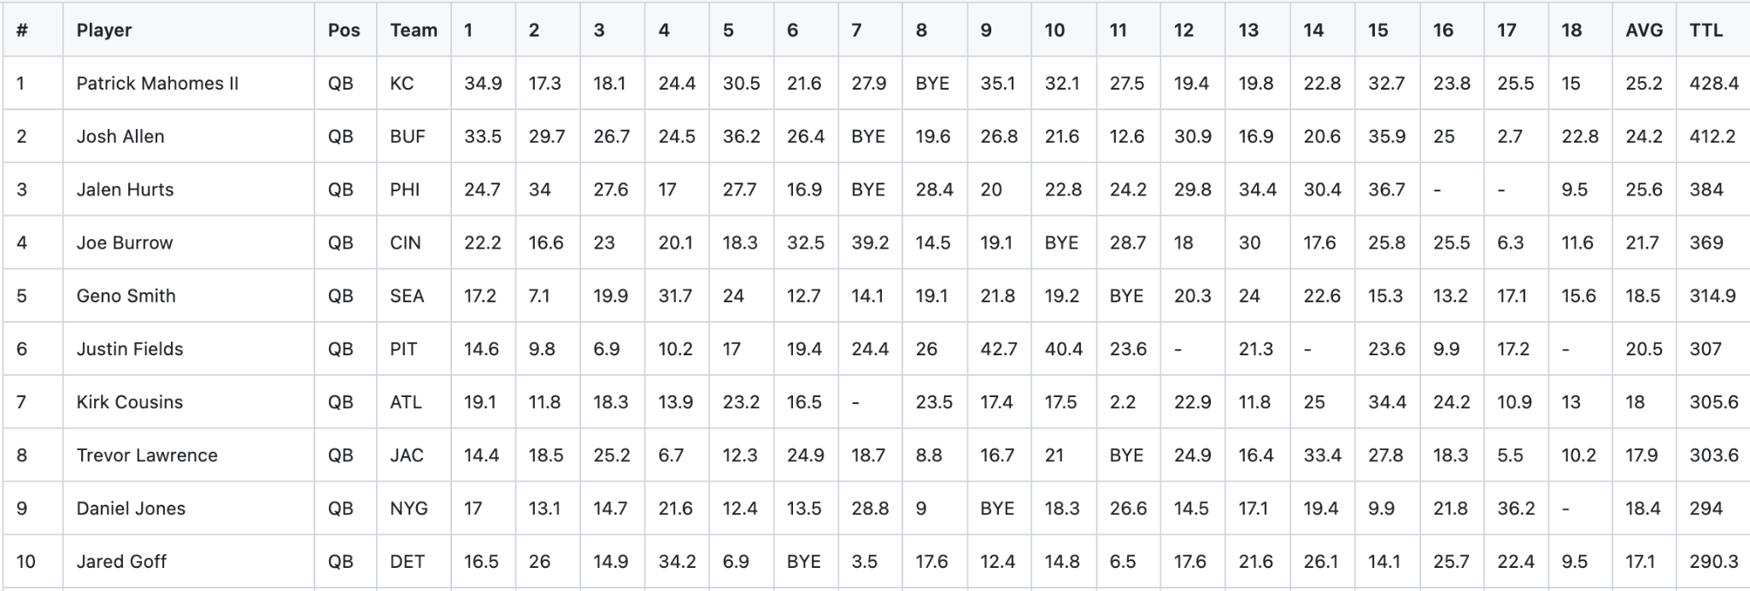
PLAYER STATS 2022

Slide 10
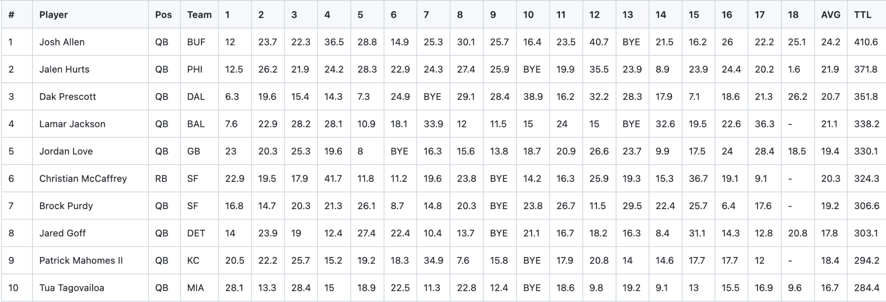
PLAYER STATS 2023

Slide 11
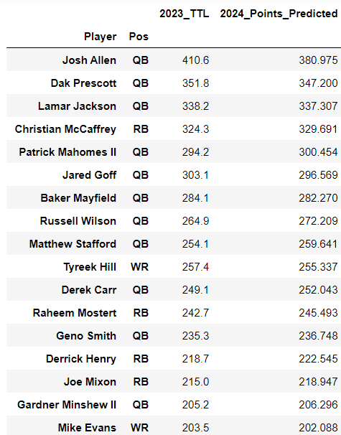
2024 PLAYERS POINT PREDICTED

Slide 12
2024 DREAM TEAM
QB - Josh Allen (Buf)
RB - Christian McCaffrey (SF)
RB - Raheem Mostert (MIA)
WR - Tyreek Hill (MIA)
WR - Mike Evans (TB)
TE - George Kittle (SF)
FLEX - Derrick Henry (BAL)
DST - Dallas Cowboys
K - Justin Tucker (BAL)
Notes:
QB - quarterback
RB - running back
WR - wide receiver
TE - tight end
FLEX - having an extra roster spot in the starting lineup for replacing a particular player who can be either a quarterback or a running back or a wide receiver.
DST - defense and special teams
K - kicker

Slide 13
THANK YOU!
Do you have any questions?

